Slide 1






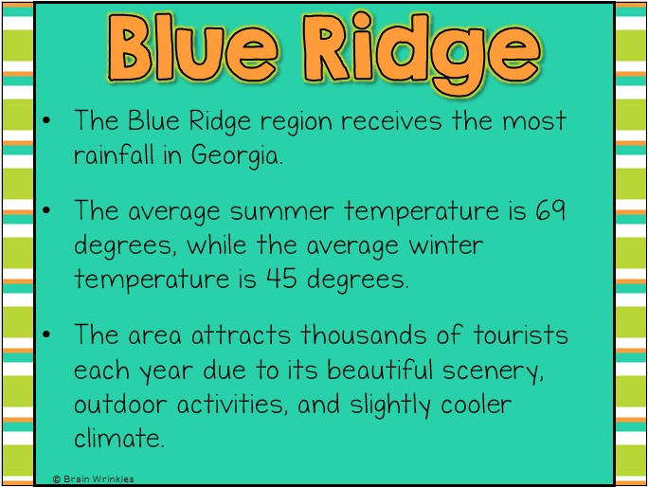
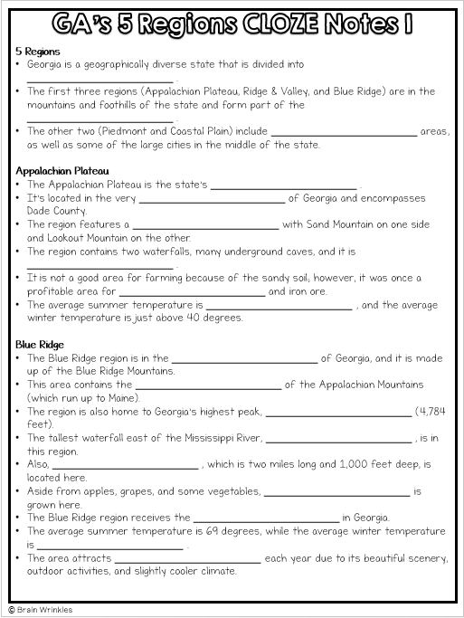
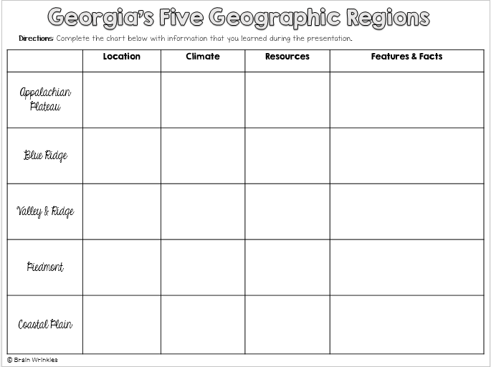






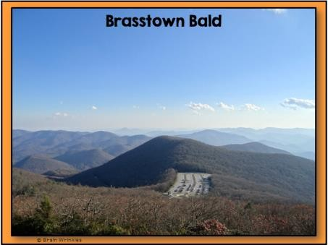

Georgia’s
Presentation, Graphic Organizers, & Activities

Slide 2


SS8G1 Describe Georgia’s geography and climate.
STANDARDS:
Locate Georgia in relation to region, nation, continent, and hemispheres.
Distinguish among the five geographic regions of Georgia in terms of location, climate, agriculture, and economic
contribution.

Slide 3

TEACHER INFO: CLOZE Notes
The next pages are handouts for the students to use for note-taking during the presentation. (Print front to back to save paper and ink.)
Check the answers as a class after the presentation.

Slide 4





5 Regions
Georgia is a geographically diverse state that is divided into
.
The first three regions (Appalachian Plateau, Ridge & Valley, and Blue Ridge) are in the mountains and foothills of the state and form part of the
.
The other two (Piedmont and Coastal Plain) include areas, as well as some of the large cities in the middle of the state.
Appalachian Plateau
The Appalachian Plateau is the state’s _ .
It’s located in the very _ of Georgia and encompasses Dade County.
The region features a with Sand ftountain on one side and Lookout ftountain on the other.
The region contains two waterfalls, many underground caves, and it is
.
It is not a good area for farming because of the sandy soil; however, it was once a profitable area for and iron ore.
The average summer temperature is , and the average winter temperature is just above 40 degrees.
Blue Ridge
The Blue Ridge region is in the of Georgia, and it is made up of the Blue Ridge ftountains.
This area contains the _ of the Appalachian ftountains (which run up to ftaine).
The region is also home to Georgia’s highest peak, (4,784 feet).
The tallest waterfall east of the ftississippi River, , is in this region.
Also, , which is two miles long and 1,000 feet deep, is located here.
Aside from apples, grapes, and some vegetables, is grown here.
The Blue Ridge region receives the in Georgia.
The average summer temperature is 69 degrees, while the average winter temperature is .
The area attracts each year due to its beautiful scenery, outdoor activities, and slightly cooler climate.
© Brain Wrinkles

Slide 5






Ridge & Valley
The Ridge and Valley region is located in , east of the Appalachian Plateau.
The region consists of several high, narrow between them.
The elevation of the region ranges from feet.
The region’s climate is similar to the Blue Ridge region, with .
are the region’s main industries.
The and agricultural products include corn, soybeans, wheat,
cotton, and apples.
are raised on pastures in the valleys.
Piedmont
The Piedmont region is in the of Georgia, and makes up roughly 30% of the state’s land area.
The name means “foot of the mountains”, as it is made up of
that slope towards the south.
The elevation ranges from 500 feet at its southern border ( ) to 1700 feet at its northern border.
The Piedmont region has large amounts of , enabling Georgia to
be the nation’s leading producer of both.
It is also known for its , which is rich in iron minerals.
The region is , with large amounts of corn, peaches, wheat, soybeans, cattle, and poultry being produced.
Nearly lives in this region, thanks to cities like Atlanta, Athens, ftacon, Columbus, Augusta, and ftilledgeville.
There are a lot of businesses in this region, and it features the .
Coastal Plain
The Coastal Plain is the , covering roughly 60% of the state.
It and extends to Georgia’s southern border with Florida.
It stretches from the off of Georgia’s eastern coast to Alabama.
The Coastal Plain has and produces the majority of the state’s crops.
, onions, pecans, corn, and other agricultural products are grown here.
The region has , which attracts large numbers of tourists each year.
The Coastal Plain and Piedmont regions are and tropical than the
other regions because they are between the warm waters of the Gulf of ftexico and the
Atlantic Ocean.
Summer tends to be long and hot, while the compared to the rest of the state.
© Brain Wrinkles

Slide 6
5 Regions
Georgia is a geographically diverse state that is divided into five regions.
The first three regions (Appalachian Plateau, Ridge & Valley, and Blue Ridge) are in the mountains and foothills of the state and form part of the Appalachian ftountain range.
The other two (Piedmont and Coastal Plain) include coastal and farming areas, as
well as some of the large cities in the middle of the state.
Appalachian Plateau
The Appalachian Plateau is the state’s smallest region.
It’s located in the very northwest corner of Georgia and encompasses Dade County.
The region features a long, narrow valley with Sand ftountain on one side and Lookout ftountain on the other.
The region contains two waterfalls, many underground caves, and it is covered in
forests.
It is not a good area for farming because of the sandy soil; however, it was once a profitable area for mining coal and iron ore.
The average summer temperature is 70 degrees, and the average winter temperature is just above 40 degrees.
Blue Ridge
The Blue Ridge region is in the northeast corner of Georgia, and it is made up of the Blue Ridge ftountains.
This area contains the southern point of the Appalachian ftountains (which run up
to ftaine).
The region is also home to Georgia’s highest peak, Brasstown Bald (4,784 feet).
The tallest waterfall east of the ftississippi River, Amicalola Falls, is in this region.
Also, Tallulah Gorge, which is two miles long and 1,000 feet deep, is located here.
Aside from apples, grapes, and some vegetables, not much agriculture is grown here.
The Blue Ridge region receives the most rainfall in Georgia.
The average summer temperature is 69 degrees, while the average winter temperature is 45 degrees.
The area attracts thousands of tourists each year due to its beautiful scenery, outdoor activities, and slightly cooler climate.
© Brain Wrinkles

Slide 7
Ridge & Valley
The Ridge and Valley region is located in northwest Georgia, east of the Appalachian Plateau.
The region consists of several high, narrow mountain ridges and the valleys between them.
The elevation of the region ranges from 700 to 1,600 feet.
The region’s climate is similar to the Blue Ridge region, with slightly less rainfall.
ftining and farming are the region’s main industries.
The soil is rich and agricultural products include corn, soybeans, wheat, cotton, and apples.
Beef cattle are raised on pastures in the valleys.
Piedmont
The Piedmont region is in the central area of Georgia, and makes up roughly 30% of the state’s land area.
The name means “foot of the mountains”, as it is made up of low rolling hills that slope
towards the south.
The elevation ranges from 500 feet at its southern border (called the Fall Line) to 1700 feet at its northern border.
The Piedmont region has large amounts of granite and marble, enabling Georgia to be the nation’s leading producer of both.
It is also known for its red clay, which is rich in iron minerals.
The region is important for agriculture, with large amounts of corn, peaches, wheat, soybeans, cattle, and poultry being produced.
Nearly 50% of Georgia’s population lives in this region, thanks to cities like Atlanta, Athens, ftacon, Columbus, Augusta, and ftilledgeville.
There are a lot of businesses in this region, and it features the bulk of Georgia’s industry.
Coastal Plain
The Coastal Plain is the largest region, covering roughly 60% of the state.
It begins at the Fall Line and extends to Georgia’s southern border with Florida.
It stretches from the barrier islands off of Georgia’s eastern coast to Alabama.
The Coastal Plain has good farmland and produces the majority of the state’s crops.
Peanuts, onions, pecans, corn, and other agricultural products are grown here.
The region has 100 miles of coast, which attracts large numbers of tourists each year.
The Coastal Plain and Piedmont regions are more humid and tropical than the other regions because they are between the warm waters of the Gulf of ftexico and the Atlantic Ocean.
Summer tends to be long and hot, while the winter is mild compared to the rest of the state.
© Brain Wrinkles

Slide 8


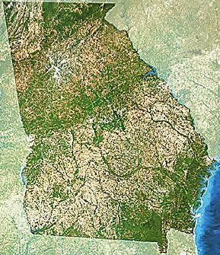








Georgia’s
© Brain Wrinkles

Slide 9




Georgia is a geographically diverse state that is divided into five regions.
The first three regions (Appalachian Plateau, Ridge & Valley, and Blue Ridge) are in the mountains and foothills of the state and form part of the Appalachian ftountain range.
The other two (Piedmont and Coastal Plain) include coastal and farming areas, as well as some of the large cities in the middle of the state.
© Brain Wrinkles

Slide 10

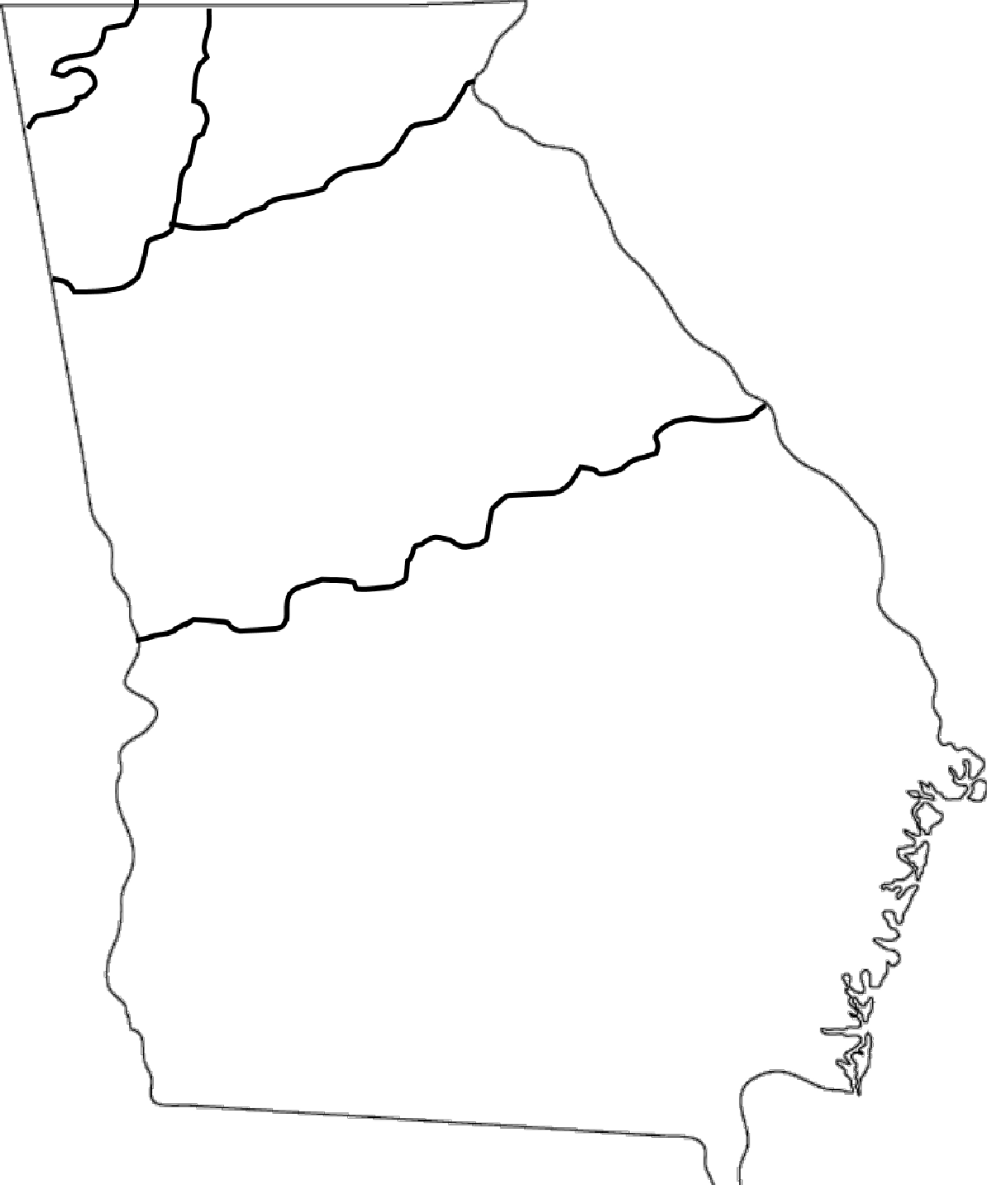
Blue Ridge
Appalachian
Plateau
Ridge & Valley
Piedmont
Coastal Plain
© Brain Wrinkles

Slide 11






The Appalachian Plateau is the state’s smallest region.
It’s located in the very northwest corner of Georgia and encompasses Dade County.
The region features a long, narrow valley with Sand ftountain on one side and Lookout ftountain on the other.
© Brain Wrinkles

Slide 12
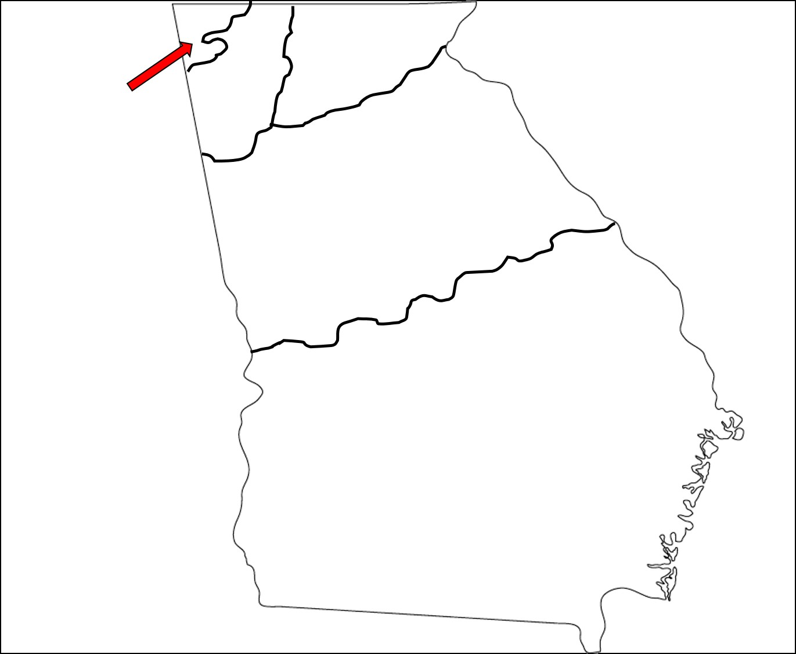
Appalachian
Plateau
© Brain Wrinkles

Slide 13

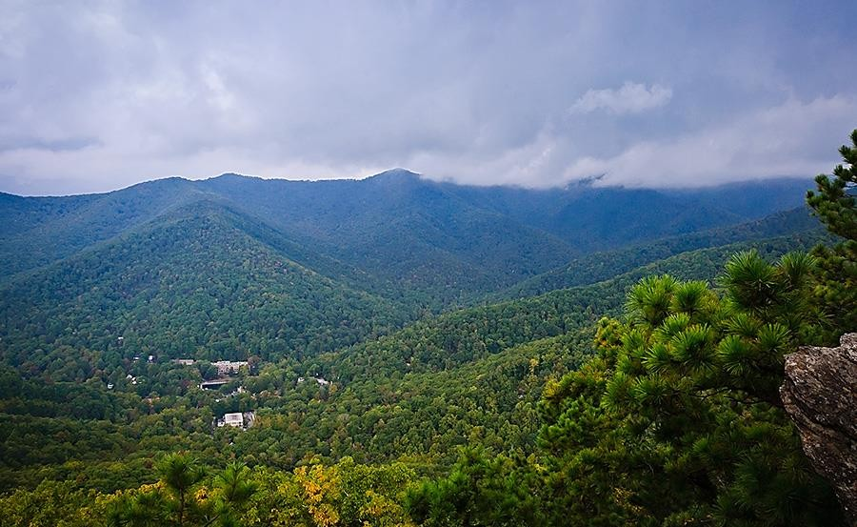
View from Lookout ftountain
© Brain Wrinkles

Slide 14
The region contains two waterfalls, many underground caves, and it is covered in forests.
It is not a good area for farming because of the sandy soil; however, it was once a profitable area for mining coal and iron ore.
© Brain Wrinkles

Slide 15

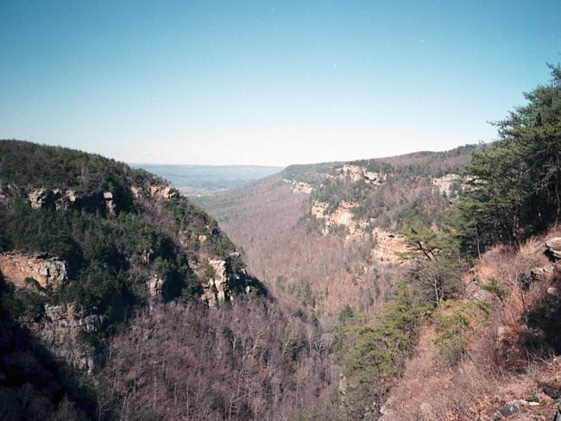

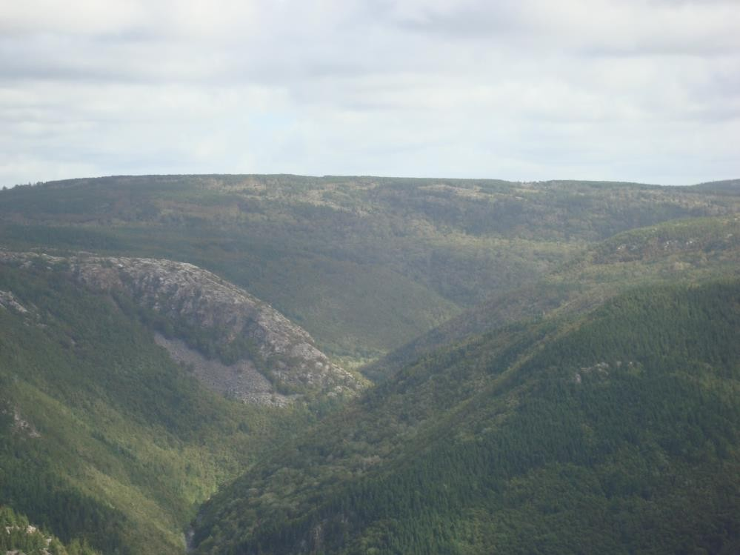
© Brain Wrinkles

Slide 16
The average summer temperature is 70 degrees, and the average winter temperature is just above 40 degrees.
© Brain Wrinkles

Slide 17



The Blue Ridge region is in the northeast corner of Georgia, and it is made up of the Blue Ridge ftountains.
This area contains the southern point of the Appalachian ftountains (which run up to ftaine).
The region is also home to Georgia’s highest peak, Brasstown Bald (4,784 feet).
© Brain Wrinkles

Slide 18

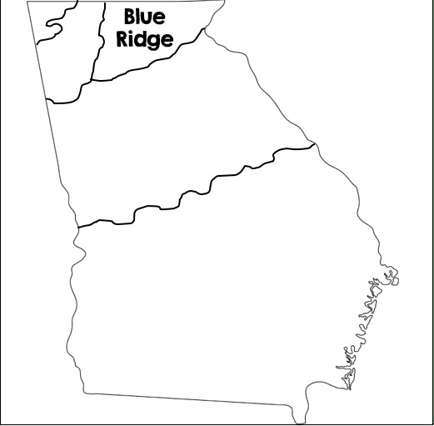
© Brain Wrinkles

Slide 19

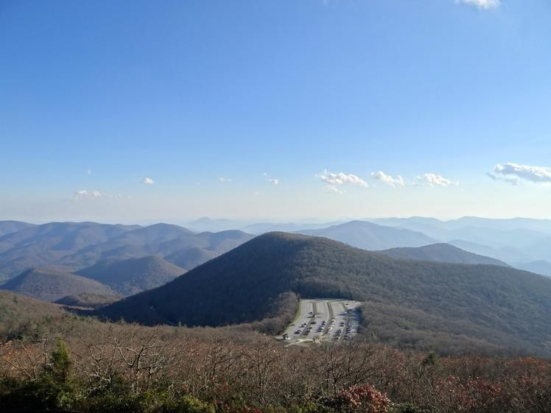
Brasstown Bald
© Brain Wrinkles

Slide 20
The tallest waterfall east of the ftississippi River, Amicalola Falls, is in this region.
Also, Tallulah Gorge, which is two miles long and 1,000 feet deep, is located here.
Aside from apples, grapes, and some vegetables, not much agriculture is grown here.
© Brain Wrinkles

Slide 21

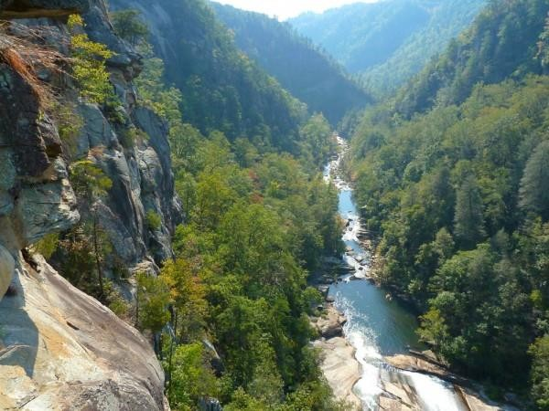

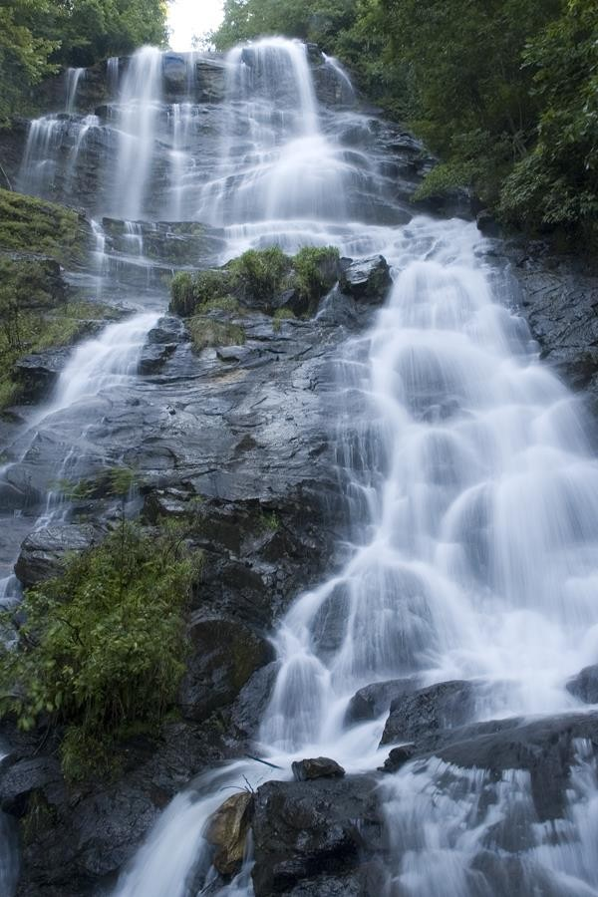
Amicalola Falls
Tallulah Gorge
© Brain Wrinkles

Slide 22
The Blue Ridge region receives the most rainfall in Georgia.
The average summer temperature is 69 degrees, while the average winter temperature is 45 degrees.
The area attracts thousands of tourists each year due to its beautiful scenery, outdoor activities, and slightly cooler climate.
© Brain Wrinkles

Slide 23

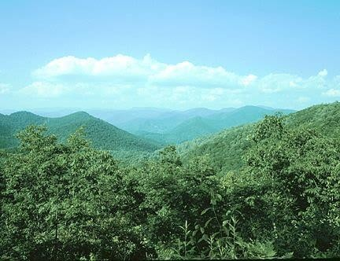

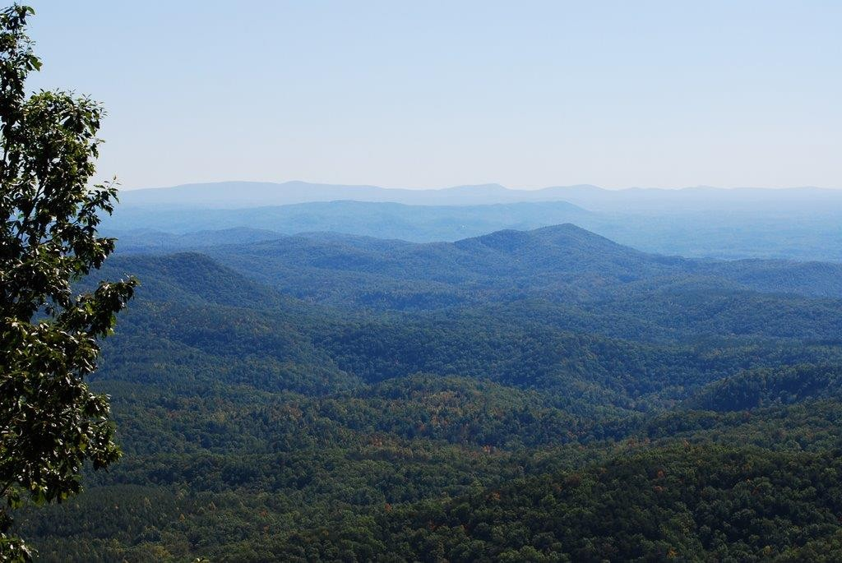
© Brain Wrinkles

Slide 24



The Ridge and Valley region is located in northwest Georgia, east of the Appalachian Plateau.
The region consists of several high, narrow mountain ridges and the valleys between them.
The elevation of the region ranges from 700 to 1,600 feet.
The region’s climate is similar to the Blue Ridge region, with slightly less rainfall.
© Brain Wrinkles

Slide 25

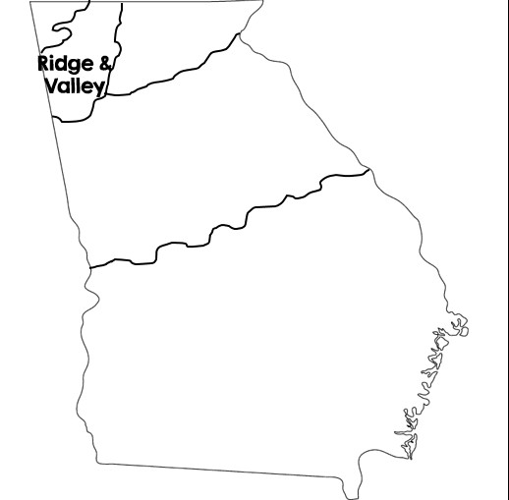
© Brain Wrinkles

Slide 26
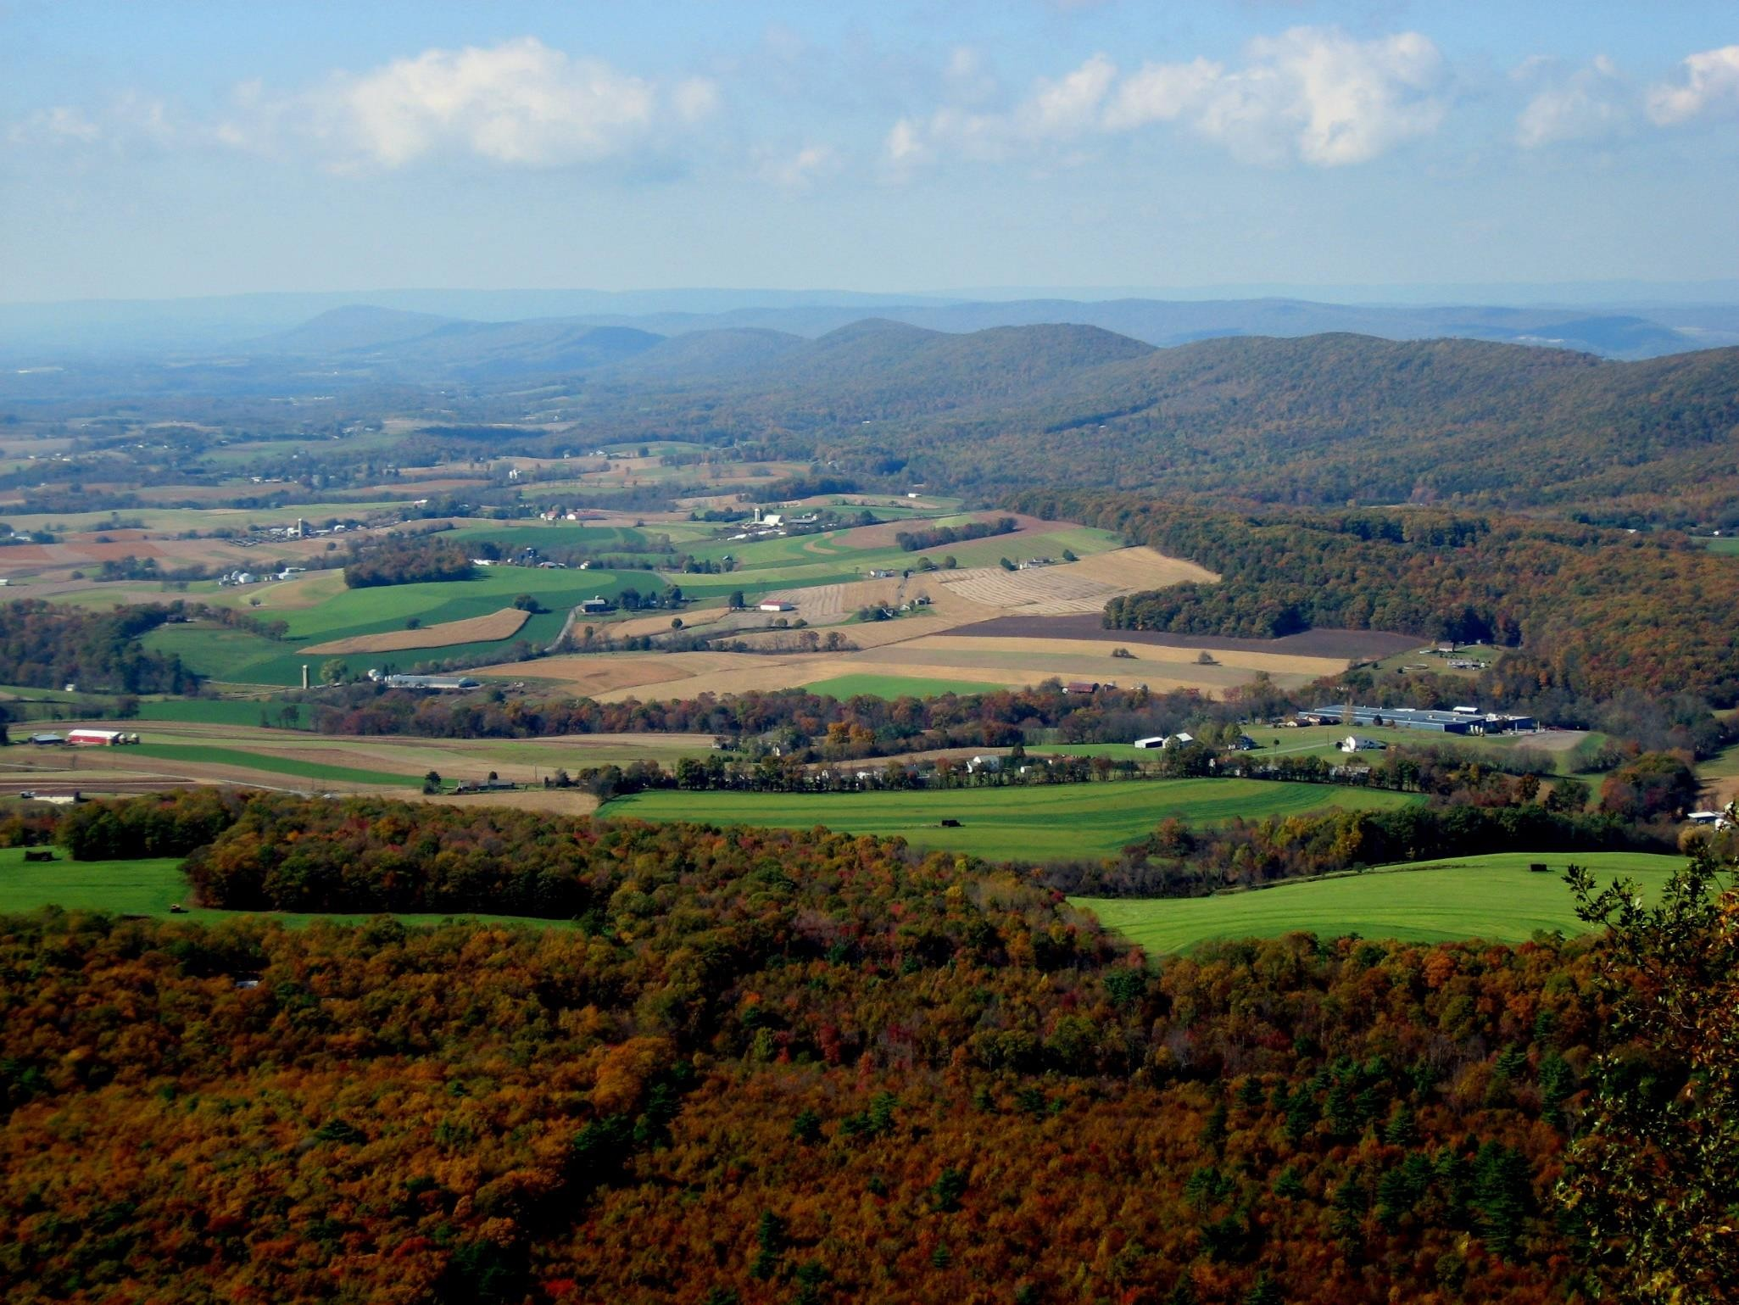
© Brain Wrinkles

Slide 27
ftining and farming are the region’s main industries.
The soil is rich and agricultural products include corn, soybeans, wheat, cotton, and apples.
Beef cattle are raised on pastures in the valleys.
© Brain Wrinkles

Slide 28

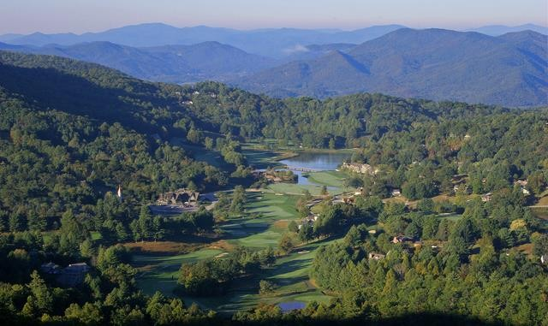

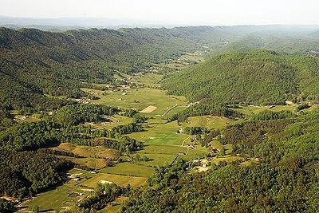
© Brain Wrinkles

Slide 29



The Piedmont region is in the central area of Georgia, and makes up roughly 30% of the state’s land area.
The name means “foot of the mountains”, as it is made up of low rolling hills that slope towards the south.
The elevation ranges from 500 feet at its southern border (called the Fall Line) to 1700 feet at its northern border.
© Brain Wrinkles

Slide 30

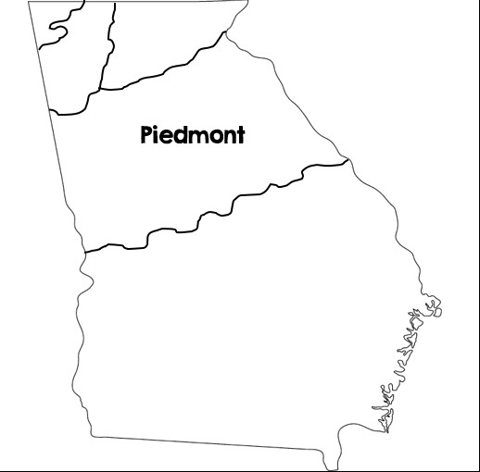
© Brain Wrinkles

Slide 31

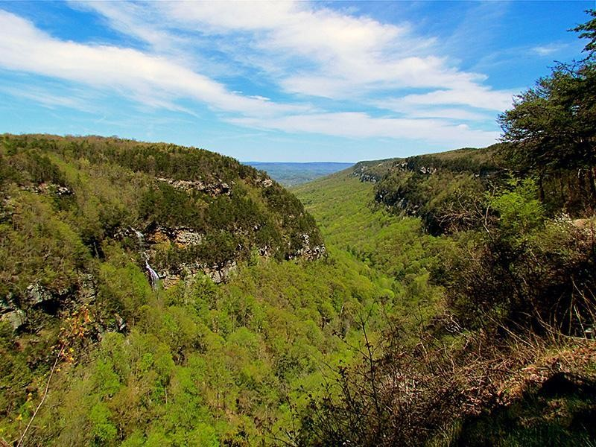

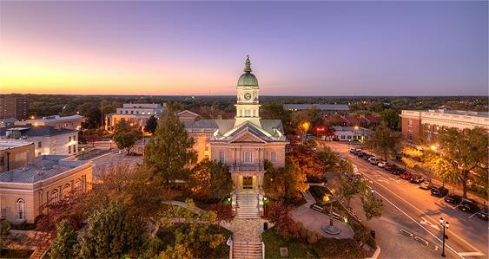
Athens, GA
© Brain Wrinkles

Slide 32
The Piedmont region has large amounts of granite and marble, enabling Georgia to be the nation’s leading producer of both.
It is also known for its red clay, which is rich in iron minerals.
The region is important for agriculture, with large amounts of corn, peaches, wheat, soybeans, cattle, and poultry being produced.
© Brain Wrinkles

Slide 33

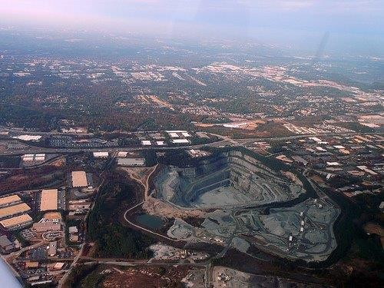
Granite Quarry in Georgia
© Brain Wrinkles

Slide 34

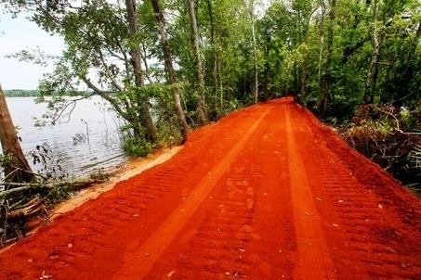
Georgia’s Red Clay
© Brain Wrinkles

Slide 35
Nearly 50% of Georgia’s population lives in this region, thanks to cities like Atlanta, Athens, ftacon, Columbus, Augusta, and ftilledgeville.
There are a lot of businesses in this region, and it features the bulk of Georgia’s industry.
© Brain Wrinkles

Slide 36

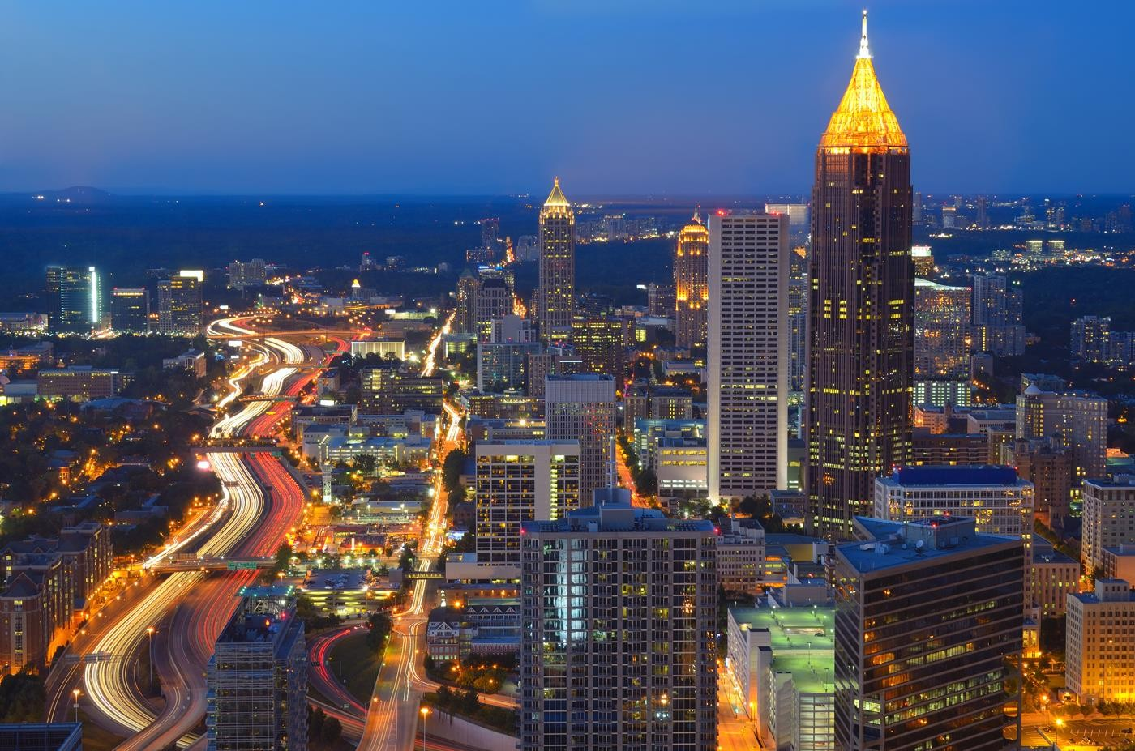
Atlanta, Georgia
© Brain Wrinkles

Slide 37



The Coastal Plain is the largest region, covering roughly 60% of the state.
It begins at the Fall Line and extends to Georgia’s southern border with Florida.
It stretches from the barrier islands off of Georgia’s eastern coast to Alabama.
© Brain Wrinkles

Slide 38

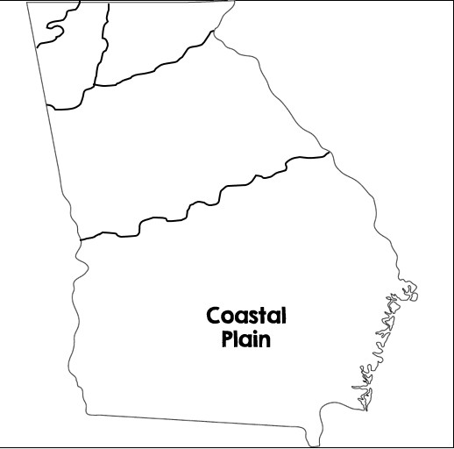
© Brain Wrinkles

Slide 39

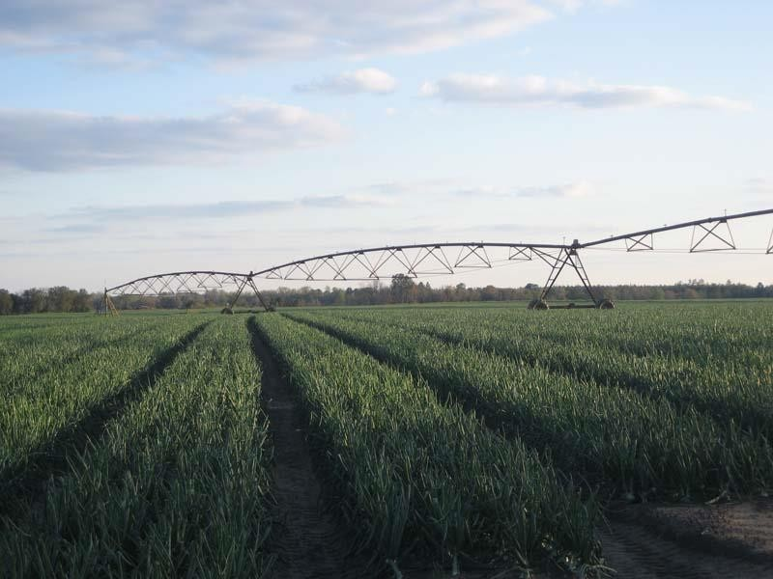
Vidalia Onions
© Brain Wrinkles

Slide 40
The Coastal Plain has good farmland and produces the majority of the state’s crops.
Peanuts, onions, pecans, corn, and other agricultural products are grown here.
The region has 100 miles of coast, which attracts large numbers of tourists each year.
© Brain Wrinkles

Slide 41

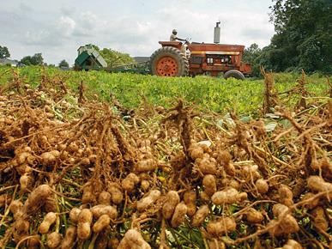
© Brain Wrinkles

Slide 42
The Coastal Plain and Piedmont regions are more humid and tropical than the other regions because they are between the warm waters of the Gulf of ftexico and the Atlantic Ocean.
Summer tends to be long and hot, while the winter is mild compared to the rest of the state.
© Brain Wrinkles

Slide 43

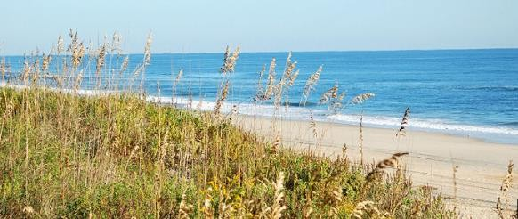
© Brain Wrinkles

Slide 44

TEACHER INFO:
Print off the following slide for each student.
They should complete the chart after discussing the presentation.
Check answers as a class when finished. If time, have students color their pictures.

Slide 45


Directions: Complete the chart below with information that you learned during the presentation.
 | Location | Climate | Resources | Features & Facts
Appalachian Plateau
Blue Ridge
Valley & Ridge
Piedmont
Coastal Plain

Slide 46




Directions: Complete the chart below with information that you learned during the presentation.
 | Location | Climate | Resources | Features & Facts
Appalachian Plateau | Northwest corner of GA (Dade County) | Summer – 70 degrees Winter – 40 degrees | Not good for farming; past = coal and iron ore | Smallest region; Sand Mountain & Lookout Mountain are here;
Blue Ridge | Northeast corner of GA; southern part of Appalachian Mountains | Receives most rainfall; summer – 69 degrees; winter – 45 degrees | Scenery and outdoor activities attract tourists ; not much agriculture other than apples, grapes, & some veggies | Contains Blue Ridge Mountains; Brasstown Bald – GA’s highest point; Amicalola Falls (highest waterfall east of Mississippi); Tallulah Gorge
Valley & Ridge | Northwest Georgia; east of Appalachian Plateau | Same as Blue Ridge – less rainfall | Mining, farming (corn, soybeans, wheat, cotton, apples, etc.), and beef cattle | High, narrow mountain ridges with valleys between; elevation between 700 to 1600 feet
Piedmont | Central region of GA; 30% of land area | Similar to Coastal Plain | Granite, marble, red clay Important region for agriculture (corn, peaches, wheat, soybeans, cattle, poultry) | Low rolling hills; 50% of population lives here; lots of industry
Coastal Plain | Largest region (60% of state); begins at Fall Line to Florida, and from east coast to Alabama | More humid and tropical; long, hot summers and mild winters | Good farmland = majority of state’s crops (peanuts, onions, pecans, onions, etc.); tourism | 100 miles of coast; barrier islands are here

Slide 47

TEACHER INFO: Regions ftap
Print off the Georgia’s Regions map for each student. (There are two-per-page.)
The students will label and color the 5 regions on the map.

Slide 48




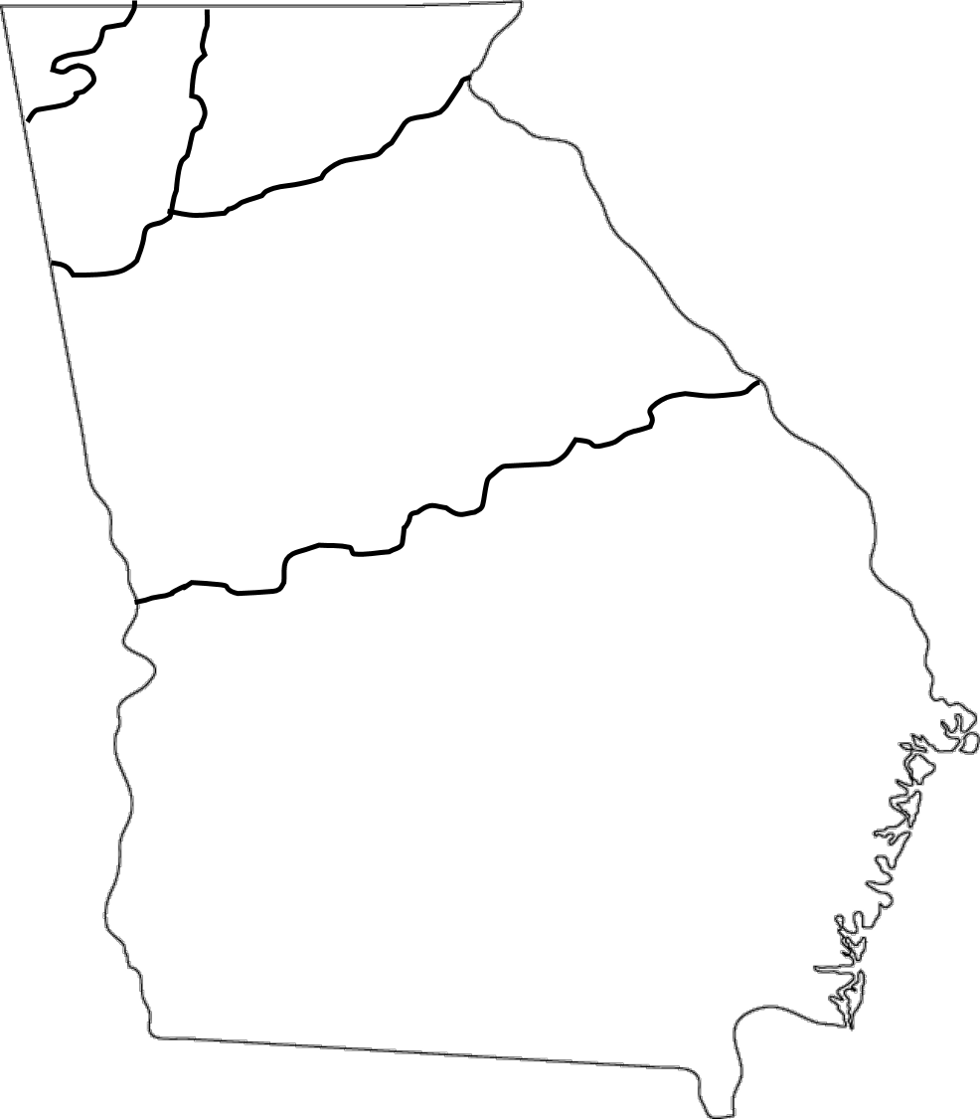
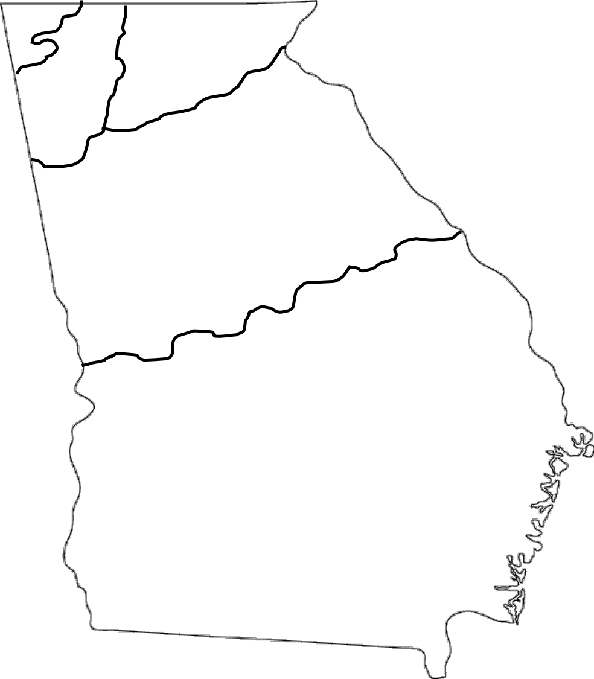
Name:
Name:
Directions: Label the following regions on the map. Lightly color each region a different color.
Directions: Label the following regions on the map. Lightly color each region a different color.
© Brain Wrinkles
© Brain Wrinkles

Slide 49

TEACHER INFO: Billboard
Print off the following slide & make a copy for each student.
The students will choose one of the five regions and create a “welcome sign” that
visitors will see as they enter the region. The sign should include key facts about the region, as well as illustrations.

Slide 50

Directions: Choose one of Georgia’s five regions and create a “welcome sign” that visitors will see as they enter the region. The sign should include key facts about the region, as well as significant illustrations.

Slide 51

TEACHER INFO: Real Estate Ad
Print off the following slide & make a copy for each student.
The students will choose one of the five regions and create an advertisement for land that is available to settle within that region.
They will write a testimonial statement that promotes the land, as well as brief descriptions of climate, land features, and resources in the region.
They will also need to include illustrations for each section.

Slide 52
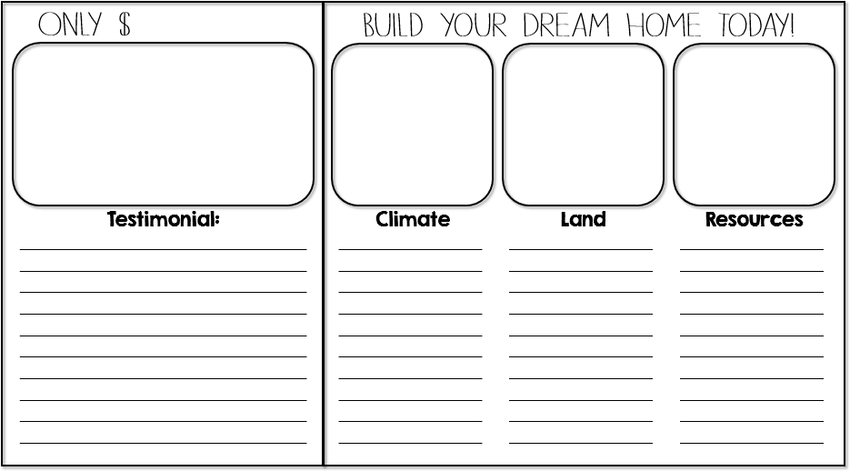
Directions: Choose one of the 5 regions in Georgia and create an advertisement for land that is available to settle within the region. Write a testimonial statement that promotes your land, as well as brief descriptions of climate, land features, and resources in the region. You should also draw illustrations of the land, climate, landforms, and resources.

Slide 53

TEACHER INFO: Pass the Paper
Put the students into small groups (you will need 5 groups total).
Print off the following Regions slides and give one paper to each group.
Give each group about 30 seconds to write down everything the know about the feature—but they can’t write something that is already written. (They can also draw pictures or symbols.)
When time is up, they must pass the paper to the next group.
This continues until every group has worked with each of the 5 papers.
Have each group share the paper & discuss the information.

Slide 54



With your group, you will have 30 seconds to write or draw everything that you know about the region on your paper.
Every group member must participate – angle yourselves so that you can all write at the same time.
The catch is that you cannot write or draw something that is already written!
When I say that time is up, you must pass the paper on
to the next group.
We will continue to “Pass the Paper” until each group has seen all of papers.
© Brain Wrinkles

Slide 55



Appalachian Plateau
© Brain Wrinkles

Slide 56


Ridge & Valley
© Brain Wrinkles

Slide 57


Blue Ridge
© Brain Wrinkles

Slide 58

Piedmont
© Brain Wrinkles

Slide 59


Coastal Plain
© Brain Wrinkles

Slide 60
TEACHER INFO: Comprehension Check
Print off the Comprehension Check for each student.
The students will complete this handout at the end of the lesson. You can count this as a quiz!
© Brain Wrinkles

Slide 61

Which region is located in the northwestern corner of Georgia?
Brasstown Bald, the highest point in Georgia, is located in which region?
What are the main industries in the Ridge and Valley region?
Which region has the highest population?
Which region is the largest?
The fall line is the geographic border between which two regions?
Name a region that would be good to visit during the summer in order to escape the heat. What could tourists do there?
What are two economic benefits of the Coastal Plain based on its
location near the Atlantic Ocean?
In which region do you live?
What is the largest city in your region?
© Brain Wrinkles

Slide 62
Which region is located in the northwestern corner of Georgia?
Appalachian Plateau
Brasstown Bald, the highest point in Georgia, is located in which region?
Blue Ridge
What are the main industries in the Ridge and Valley region? ftining and farming
Which region has the highest population? Piedmont
Which region is the largest? Coastal Plain
The fall line is the geographic border between which two regions? Piedmont and Coastal Plain
Name a region that would be good to visit during the summer in order to escape the heat. What could tourists do there?
Answers will vary. Example—Blue Ridge: hiking
What are two economic benefits of the Coastal Plain based on its location near the Atlantic Ocean?
Fishing and shipping
In which region do you live? Answers will vary.
What is the largest city in your region? Answers will vary
© Brain Wrinkles

Slide 63
TEACHER INFO: TICKET OUT THE DOOR
Print off the following slide & make a copy for each student. (They are two-per-page).
Have the students create a snapchat message for one of the geographic regions from the lesson.
The message should include an illustration that represents the region, as well as text to describe it.
Collect these as the students leave the classroom.
© Brain Wrinkles

Slide 64











Name:
Name:
Create a snapchat about one of Georgia’s five regions. Include a visual and text to describe the region.
Create a snapchat about one of Georgia’s five regions. Include a visual and text to describe the region.
To: From:
Text:
To: From:
Text:
© Brain Wrinkles
© Brain Wrinkles

Slide 65







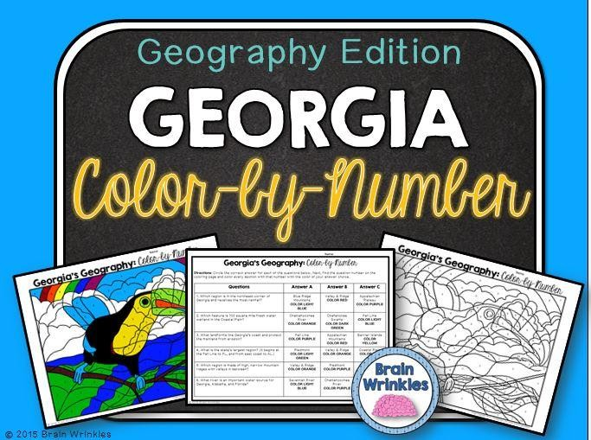



Thank you so much for downloading this file. I sincerely hope you find it helpful and that your students learn a lot from it! I look forward to reading your feedback in my store.
If you like this file, you might want to check out some of my other products that teach social studies topics in creative, engaging, and hands-on ways.
Best wishes,
Ansley at Brain Wrinkles

Slide 66






© Brain Wrinkles. Your download includes a limited use license from Brain Wrinkles. The purchaser may use the resource for personal classroom use only. The license is not transferable to another person. Other teachers should purchase their own license through my store.
This resource is not to be used:
By an entire grade level, school, or district without purchasing the proper number of licenses. For school/district licenses at a discount, please contact me.
As part of a product listed for sale or for free by another individual.
On shared databases.
Online in any way other than on password-protected website for student use only.
© Copyright Brain Wrinkles. All rights reserved. Permission is granted to copy pages specifically designed for student or teacher use by the original purchaser or licensee. The reproduction of any other part of this product is strictly prohibited. Copying any part of this product and placing it on the Internet in any form (even a personal/classroom website) is strictly forbidden. Doing so makes it possible for an Internet search to make the document available on the Internet, free of charge, and is a violation of the Digital Millennium Copyright Act (DMCA).
Thank you,
Ansley at Brain Wrinkles
Clipart, fonts, & digital papers for this product were purchased from:

